Slide 1
Face Recognition
Deep Learning Phyton és LUA alapokon tárgyra készült házi feladat
*Rise of AI*
Tugyi Beatrix (T63K63)
El-Ali Maya (BHI5LF)
Simkó Máté (O3BMRX)

Slide 2
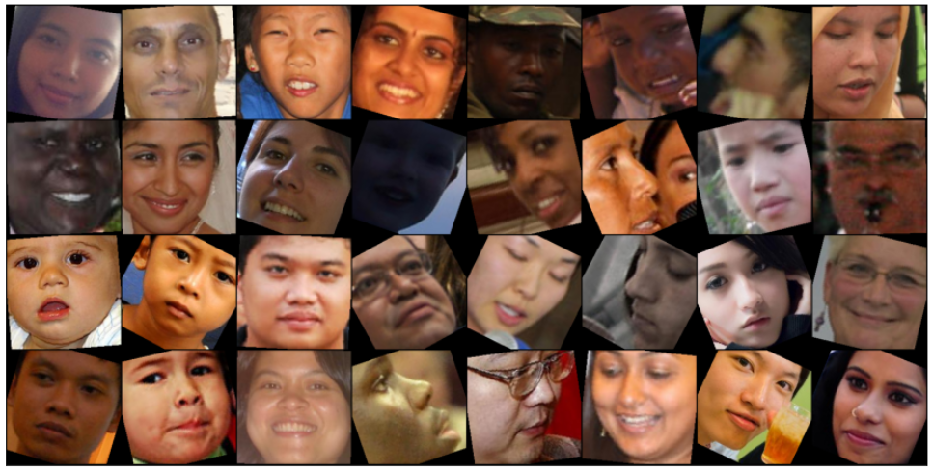
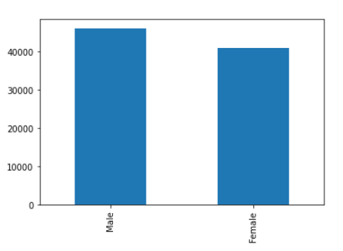
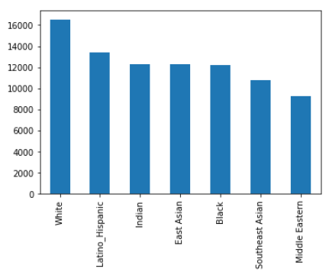
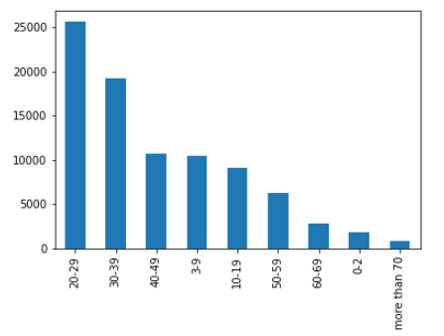
Dataset
FairFace dataset
97698 images
labeled with gender, age, and race
Race balanced

Slide 3
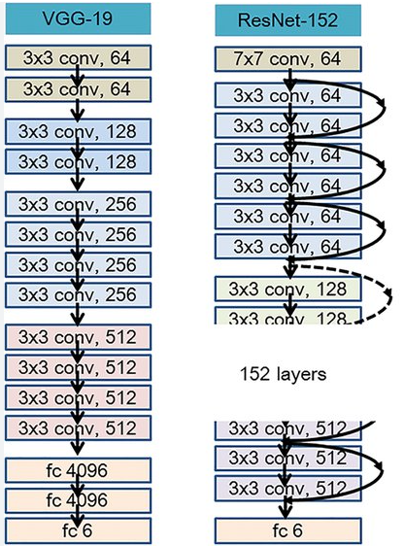
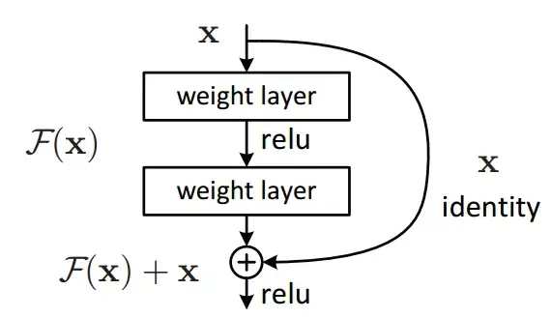
Pretrained Models
VGG - 2013
ResNET -2015
- Residual connections ->
Transfer learning
Freeze the weights of the base model
Add linear layers and train them

Slide 4
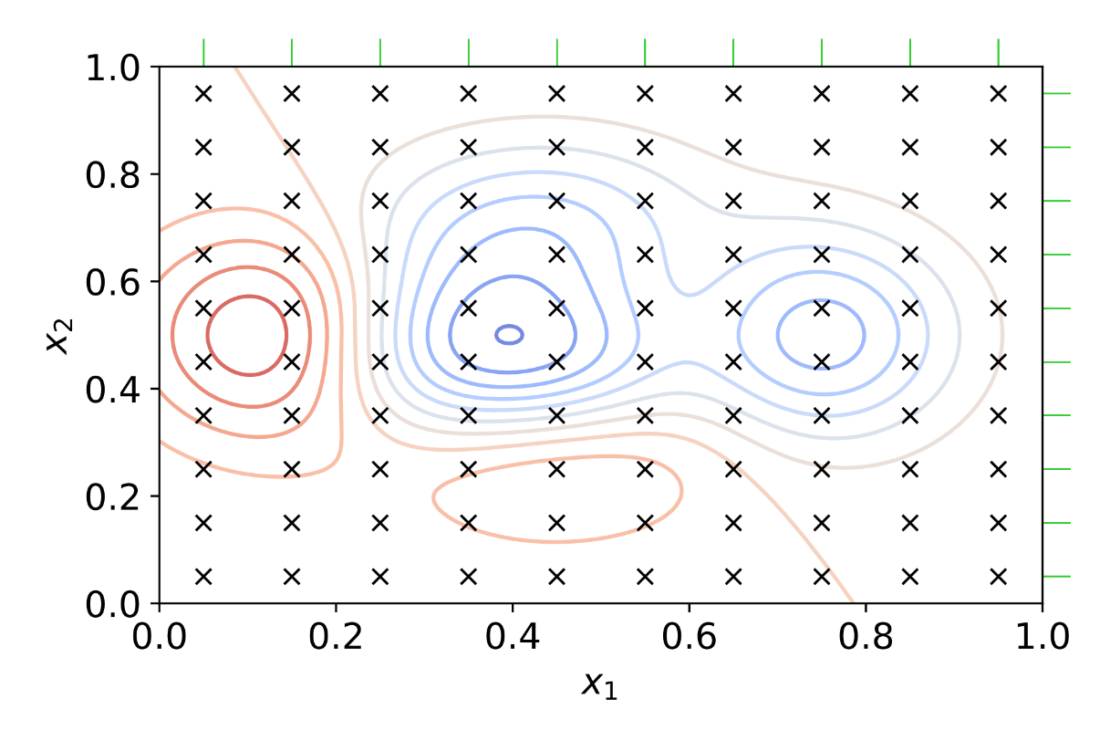
Optimization
Parameters
Optimalization
Learning rate
Weight Decay (L2 regularization)
Batch size
Size of hidden state

Slide 5
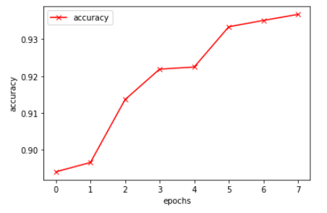
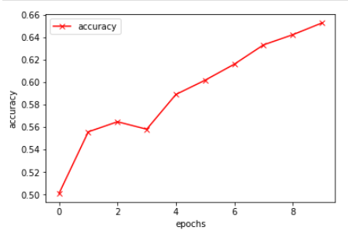
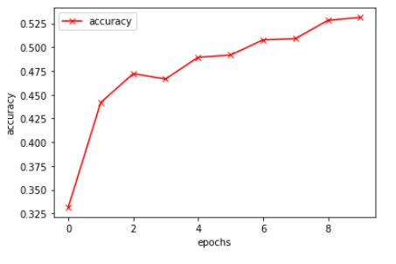
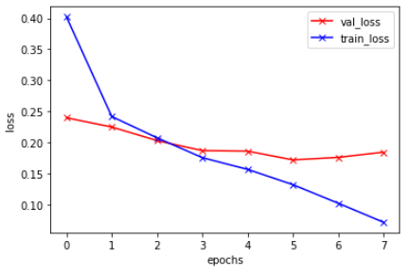
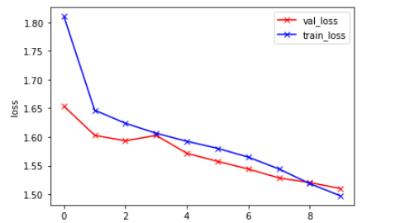
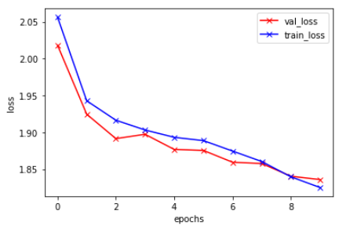
Training (ResNET)
With Pytorch and Google Colab’s GPU
Gender
Race
Age

Slide 6
Results

Slide 7
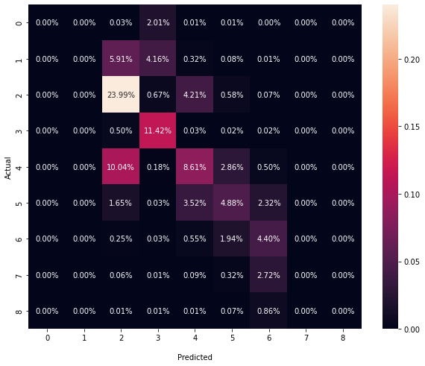
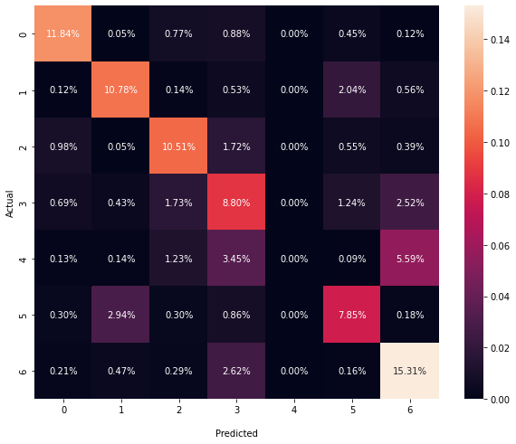
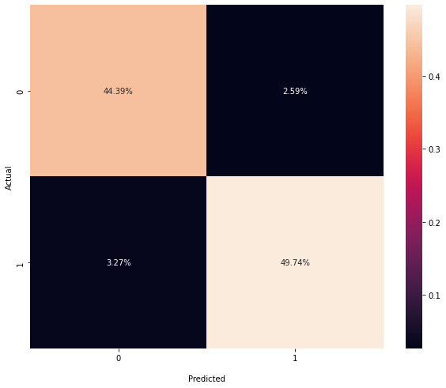
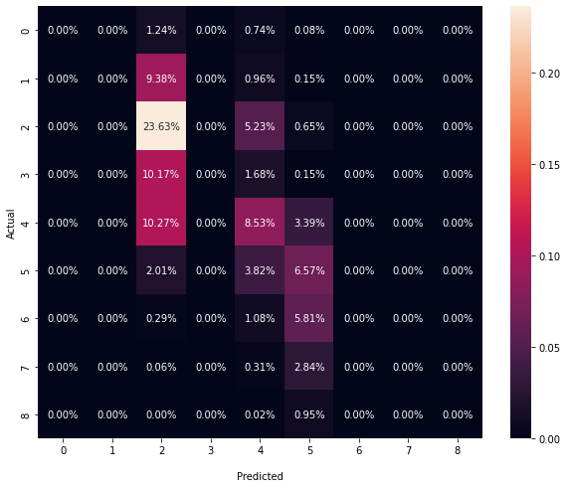
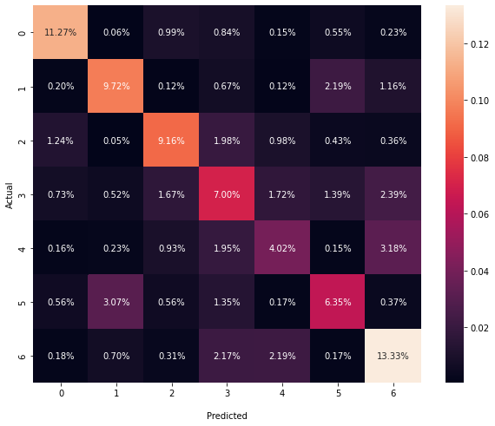

Evaluation
Age
Race
Gender
ResNET
VGG

Slide 8
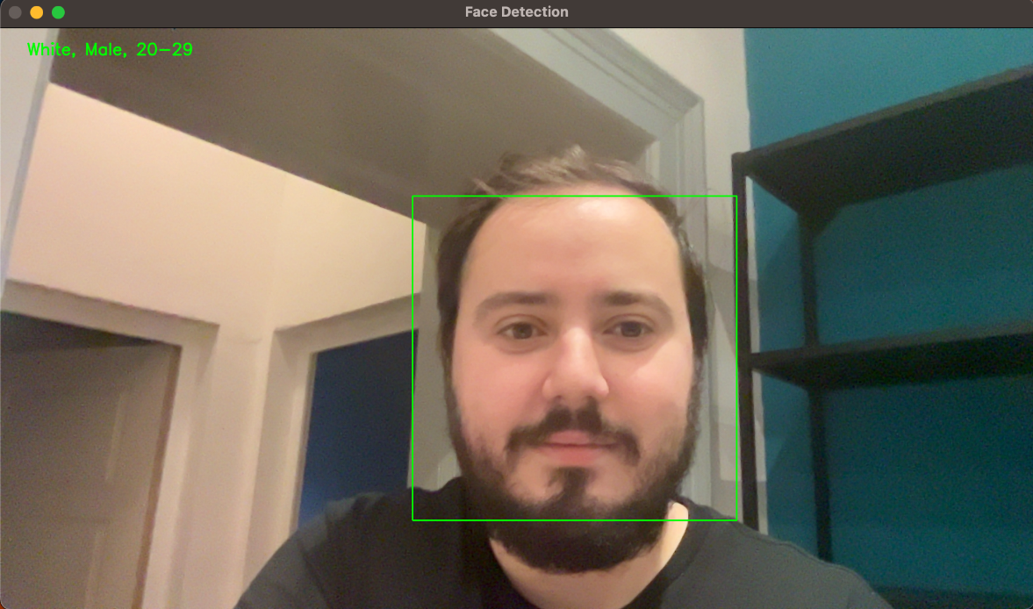
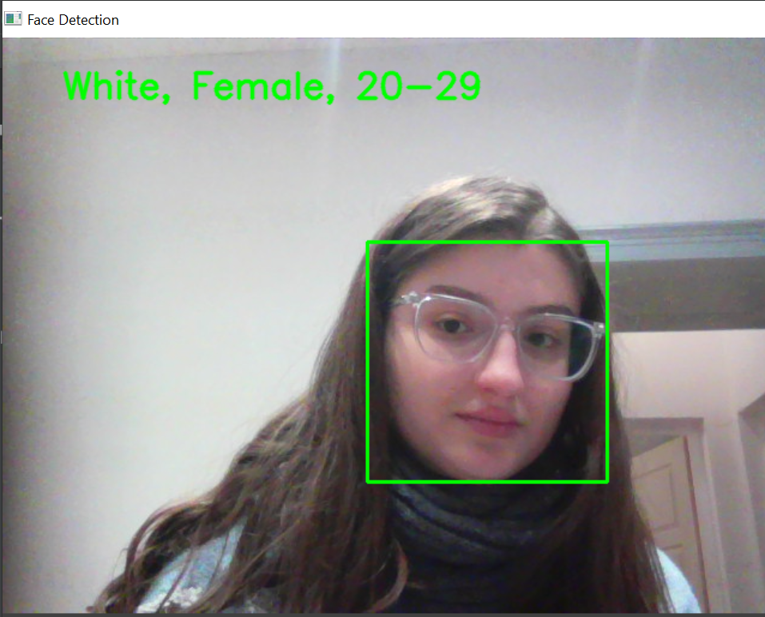
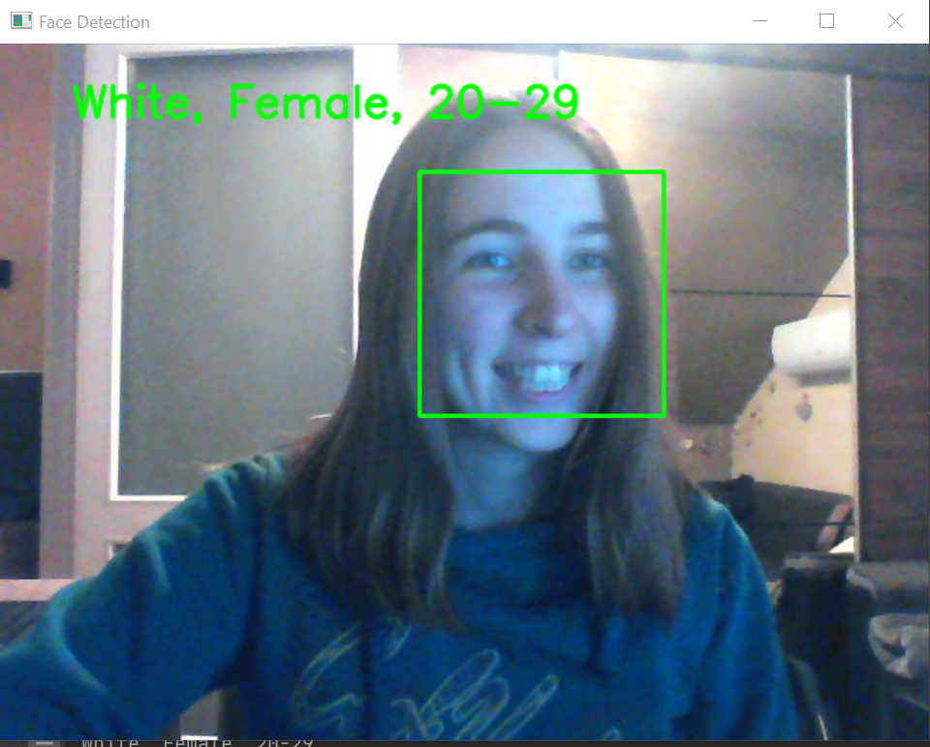
Application DEMO
Pytorch model loading
Cv2 based webcamera flow
Face detection with haar cascade

Slide 9
Summary
Future Plans
Improving the Multi target model
Image Generation
- GAN
- VAE
- Diffusion models
Adapt the application for mobile use
Individual label classification was successful
ResNET outperformed VGG
Best results at Gender labels

Slide 10
Köszönjük a figyelmet!

